Slide 1



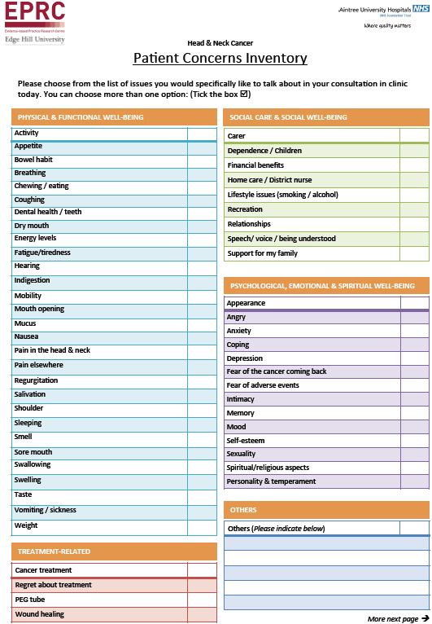
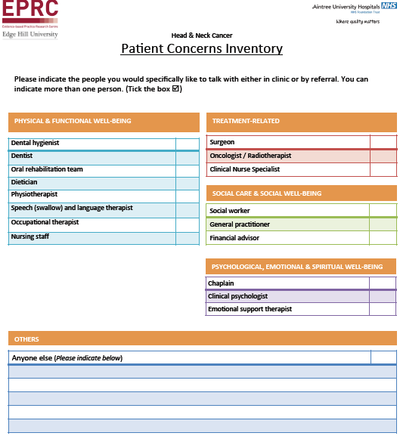
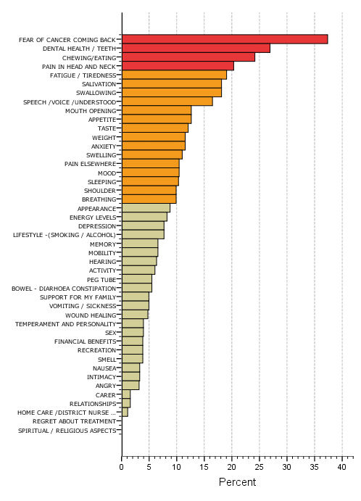
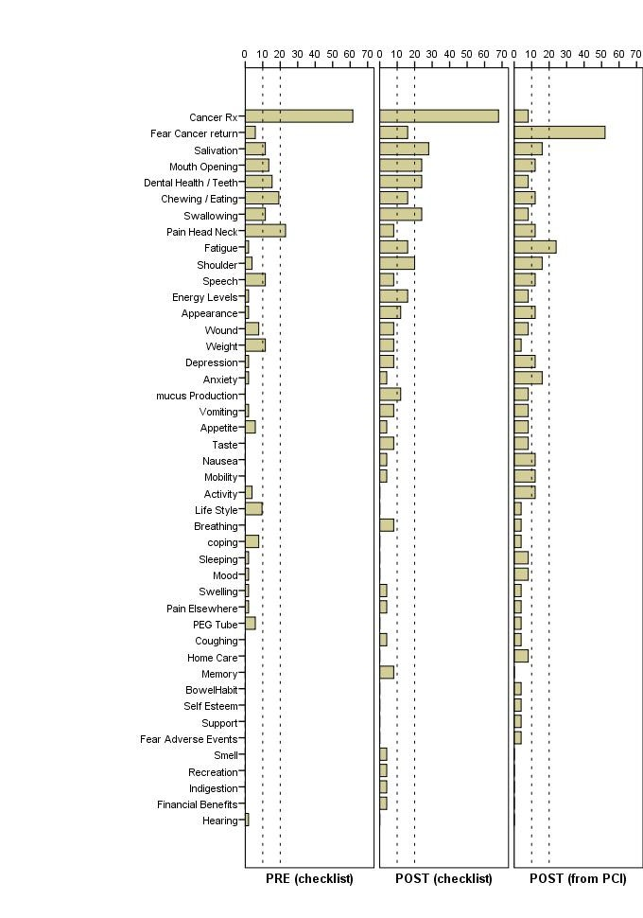
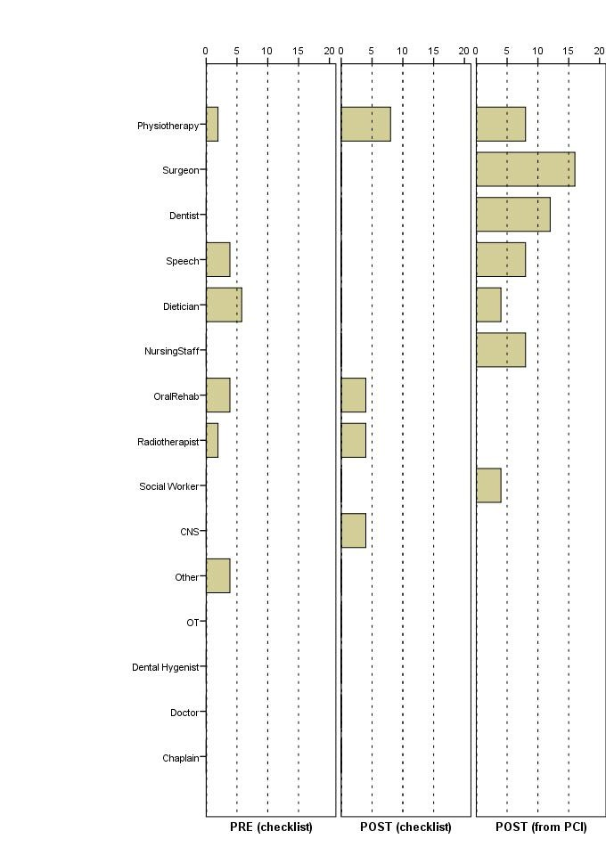
The Patient Concerns Inventory: A Tool to Uncover Unmet Needs in a Cancer Out-Patient Clinic
N Ghazali¹, A Kanatas² , F Bekiroglu¹ ,B Scott¹, D Lowe³, SN Rogers^{1,3}
¹ Aintree University Hospitals NHS Foundation Trust
² Leeds Teaching Hospitals NHS Trust
³ Evidence-Based Practice Research Centre, Faculty of Health, Edge Hill University
Email: barry.scott@aintree.nhs.uk
Background
Results
  The Patient Concerns Inventory (PCI) is a holistic tool introduced to help identify potential unmet needs of patients attending a head and neck cancer follow-up clinic.
  It is a 57 item checklist of issues that may be grouped into categories such as physical and functional well-being, social care and social well-being (figure 1).
  The PCI also gives the patients an opportunity to identify from a list of 17 multidisciplinary team (MDT) members whom they would like to see or be referred on to (figure 2).
  ‘Fear of recurrence’ is the most common issue wished to be discussed when using the PCI¹ (figure 3).
  ‘Cancer treatment’ was the issue most discussed in 60–70% of consultations (figure 4).
  After the introduction of the PCI, with the notable exception of ‘cancer treatment’ and ‘fear of recurrence’, the rates of discussion of other concerns / issues occurring within consultation were broadly similar to levels selected by patients themselves when completing the PCI (figure 5).
  The PCI helped raise issues that otherwise could be missed and allows onward support from other members of the team (figure 6).
Aims
Discussion and Conclusions
  To assess the impact of the PCI and to evaluate its use with a Consultant previously not experienced in the use of the PCI.
  To evaluate its impact on length of consultation, the number of items raised in the consultation and the number of onward referrals made to MDT members.
This study evaluated the early experiences and impact of introducing the PCI into clinical practice with a Consultant and patients unfamiliar with the tool.
This study gives valuable insight into how the PCI in clinical practice may facilitate head and neck cancer patient-doctor interaction.
Findings can be a useful practical pointer for other clinics that are developing the PCI for application into follow-up clinics of other cancer types.
Findings provide a window into the possible implementation of a simple holistic needs assessment tool in clinics for post-treatment survivors.
This study demonstrated that even when patients identify issues to discuss on paper, if not brought up in conversation by the Consultant then the issue remains not discussed.
Study adds further weight to previous evidence in the use of the PCI in clinical practice.
Figure 1: The 57 items of the Patient Concerns Inventory (PCI)
Figure 2: The 17 multidisciplinary team (MDT) members
Figure 3: The top 10 issues patients wish to discuss
Methods
  Subjects eligible for this study were post treatment, disease free head and neck cancer patients undergoing routine follow-up visits for surveillance.
  Prospective, observational study carried out in two phases; (1) control phase, representing the period prior to the introduction of the PCI in clinics and (2) PCI implementation phase when the PCI was introduced into clinics.
  A total of 106 patients were included, 52 in the control phase and 54 in the implementation phase.
  Data collection included observational data made during the consultation about which issues were discussed and which multidisciplinary professionals were referred to.
  Issues discussed during consultations were recorded on paper in real time by the researcher (BS).
References
Rogers SN, El-Sheikha J, Lowe D (2009). The development of a Patients Concerns Inventory (PCI) to help reveal patients concerns in the head and neck clinic. Oral Oncology 45: 555-61.#
www.headandneckcancer.co.uk
Figure 4: Issues discussed during consultation
Figure 5: Issues identified on the Patient Concerns Inventory for discussion by patient
Figure 6: Referrals to MDT members

